Slide 1

How to gather SPO audit reports using Office 365 Management API?
Pankaj Surti (Sr. Consultant)
Notes:
Description:
The Office 365 Management Activity API is for auditing end-user activities in the various workloads. The API can allow gathering auditing logs which can be useful to create dashboards and reports. My customer asked the SharePoint Site Collection Audit reports for SharePoint Online are not present as it was available for the SharePoint On-premises. The audit logs for the SharePoint workloads are an answer for getting such a report. In this presentation, I will go through the details and use of these APIs and solutions to develop the report.

Slide 2
Learning Objectives
Learn about Office 365 Management API
1
Learn how to use Office 365 Management API to gather the Audit Data for various workloads
2
Learn how to report the collected data in the Power BI dashboard
3

Slide 3
Current Issues reported by SCAs for the SPO sites
SPO Customers do not receive the same GUI presentation for site audit reports that were available on the SharePoint on-premises.
Currently, the reports are available only in the CSV files.
Currently, O365Tenant admins must run the report to get the CSV files

Slide 4
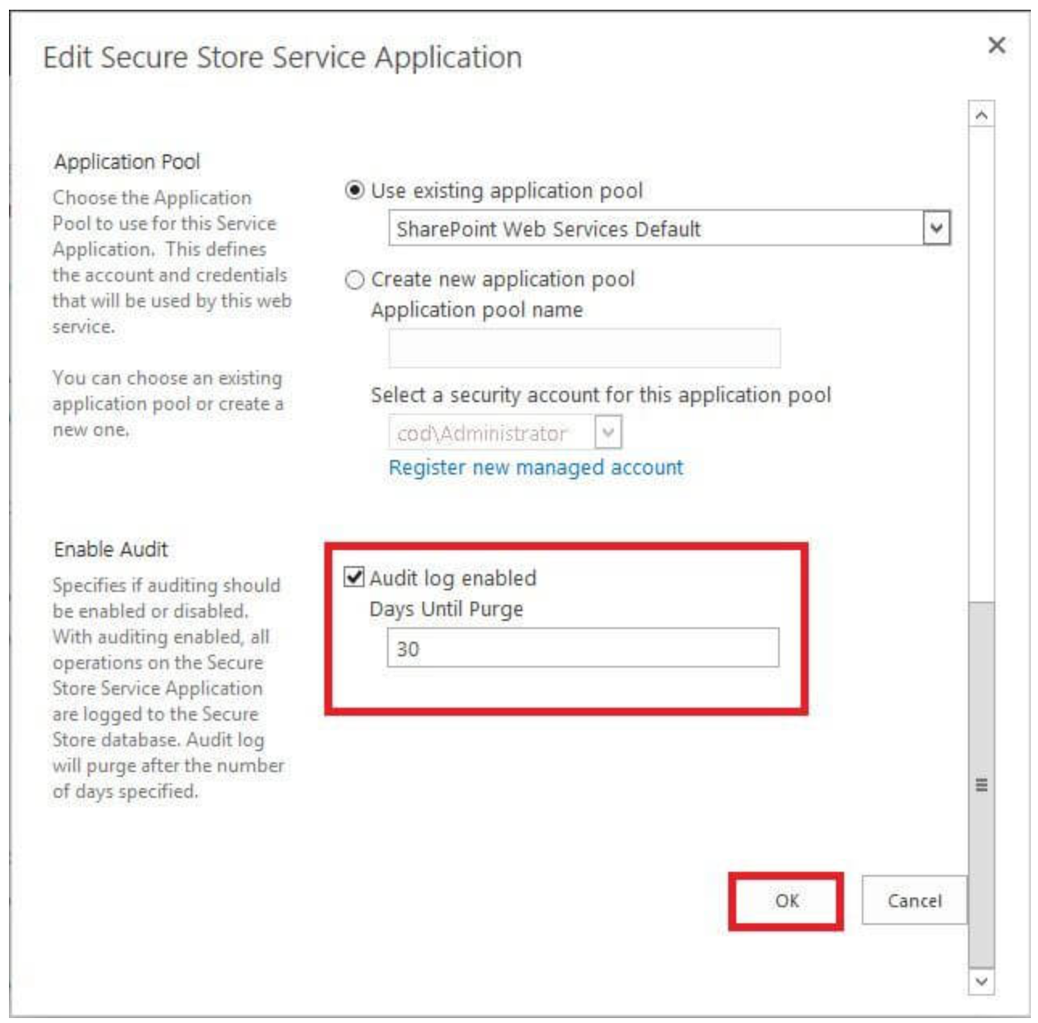
Enable Audit Log Feature in Central Administration Site

Slide 5
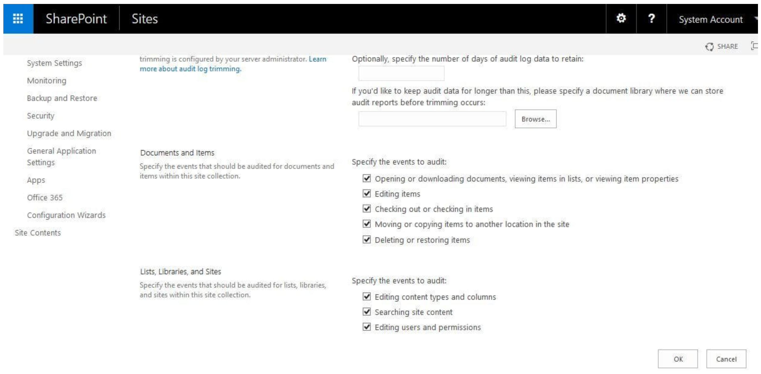

Slide 6

Solution is to use Office 365 Management API to get Audit Logs
Audit.SharePoint data

Slide 7
What is Office 365 Management API?
There are two type of the APIs.
1. Office 365 Service Communications API
Get Services: Get the list of subscribed services.
Get Current Status: Get a real-time view of current and ongoing service incidents.
Get Historical Status: Get a historical view of service incidents.
Get Messages: Find Incident and Message Center communications.
2. Office 365 Management Activity API
Use the Office 365 Management Activity API to retrieve information about user, admin, system, and policy actions and events from Office 365 and Azure AD activity logs.
Audit and activity logs to create solutions that provide monitoring, analysis, and data visualization.
Notes:
The Management Activity API is for auditing end user activities in the various workloads.
The Service Communications API is for auditing status and messages that are sent by the services that are available in Office 365 (such as Dynamics CRM or Identity Service).

Slide 8
Workloads for Office 365 Management API
Audit.AzureActiveDirectory
Audit.Exchange
Audit.SharePoint
Audit.General (includes all other workloads not included in the previous content types)
DLP.All (DLP events only for all workloads)

Slide 9
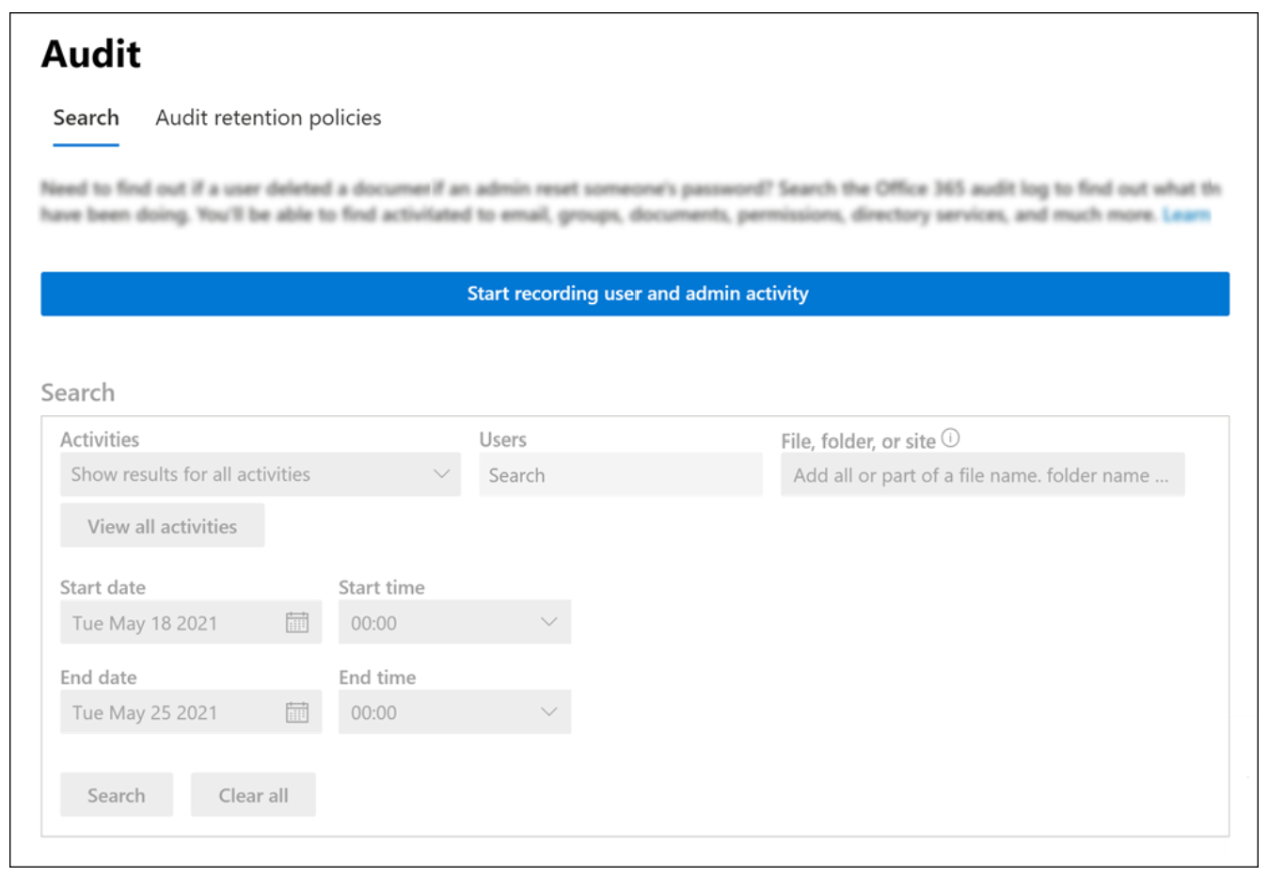
Compliance Center to turn on auditing
Notes:
Go to https://compliance.microsoft.com and sign in.
In the left navigation pane of the Microsoft 365 compliance center, click Audit.
If auditing is not turned on for your organization, a banner is displayed prompting you start recording user and admin activity.
Click the Start recording user and admin activity banner.
It may take up to 60 minutes for the change to take effect.

Slide 10
Steps to get audit logs and dashboard
Register an Azure AD App
Add and grant consent to the following Application permissions.
Office 365 Management API
ActivityFeed.Read
ActivityFeed.ReadDlp
ServiceHealth.Read
Start a subscription for a workload
Run “QueueEvent” event on a Timer at midnight
The above step will run the “StoreEvent” to store JSON logs in the Azure Cosmos DB.
Using Power BI read the JSON file to plot the reports.

Slide 11
Start a subscription
REQUEST
POST {root}/subscriptions/start?contentType=Audit.SharePoint&PublisherIdentifier={tenantGUID}
Content-Type: application/json; utf-8
Authorization: Bearer eyJ0e...Qa6wg
RESPONSE
HTTP/1.1 200 OK
Content-Type: application/json; charset=utf-8
{
"contentType": "Audit.SharePoint",
"status": "enabled",
}

Slide 12
Activity API operations
https://manage.office.com/api/v1.0/{{TenantID}}/activity/feed/subscriptions/content?
startTime={{startTime}}&
endTime={{endTime}}&
contentType={{contentType}}&
PublisherIdentifier={{TenantID}}
[
{
"contentUri": "https://manage.office.com/api/v1.0/b07282ed-2513-42ff-8322-de55ebce98f1/activity/feed/audit/20220404172343761148151$20220405052516832093374$audit_sharepoint$Audit_SharePoint$na0034",
"contentId": "20220404172343761148151$20220405052516832093374$audit_sharepoint$Audit_SharePoint$na0034",
"contentType": "Audit.SharePoint",
"contentCreated": "2022-04-05T05:25:16.832Z",
"contentExpiration": "2022-04-11T17:23:43.761Z"
},
{

Slide 13
{
"AppAccessContext": {
"AADSessionId": "5e5d69ef-a701-4ff7-9068-adc9eaa444ba",
"CorrelationId": "ff8230a0-20f5-c000-c88a-0b7be49d5f5b",
"UniqueTokenId": "bflaGhwgWUuOpcy6h_cdAA"
},
"CreationTime": "2022-04-04T19:17:56",
"Id": "aa088334-d15b-413b-3ed1-08da166fd2f6",
"Operation": "FileAccessed",
"OrganizationId": "b07282ed-2513-42ff-8322-de55ebce98f1",
"RecordType": 6,
"UserKey": "i:0h.f|membership|1003200196c135af@live.com",
"UserType": 0,
"Version": 1,
"Workload": "SharePoint",
"ClientIP": "152.129.0.12",
"ObjectId": "https://devva.sharepoint.com/sites/appcatalog/clientsideassets/c40b89d1-d05f-4623-b02e-b78276a050d2/navigation-panel-application-customizer_039e677240705a0c1bbc4023a93bf51e.js",
"UserId": "spdevadmin@o365dev.va.gov",
"CorrelationId": "ff8230a0-20f5-c000-c88a-0b7be49d5f5b",
"CustomUniqueId": false,
"EventSource": "SharePoint",
"ItemType": "File",
"ListId": "300cfa22-0c1e-411b-a10e-7d6b81978e76",
"ListItemUniqueId": "a25248f3-f04d-4442-b184-accadd27335c",
"Site": "7b8c0cf1-acef-4e86-b3dc-009f68708b39",
"UserAgent": "Mozilla/5.0 (Windows NT 10.0; Win64; x64) AppleWebKit/537.36 (KHTML, like Gecko) Chrome/99.0.4844.74 Safari/537.36 Edg/99.0.1150.46",
"WebId": "aaae54a6-b040-43b4-965f-55aaa97b95df",
"SourceFileExtension": "js",
"SiteUrl": "https://devva.sharepoint.com/sites/AppCatalog/",
"SourceFileName": "navigation-panel-application-customizer_039e677240705a0c1bbc4023a93bf51e.js",
"SourceRelativeUrl": "ClientSideAssets/c40b89d1-d05f-4623-b02e-b78276a050d2"
}

Slide 14

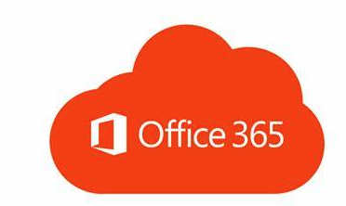

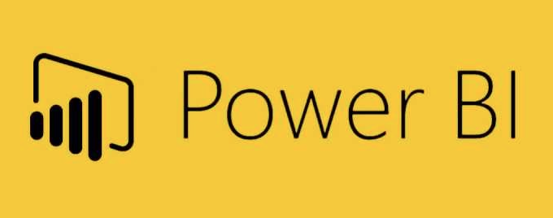

Architecture
Queue
Events
(Azure Function)
Initially Subscribed to
Audit.SharePoint
DLP.All
Audit.Exchange
Audit.General
Audit.AzureAD
Office 365 Management API
Azure Storage Queue (N/A)
Azure Service Bus (Premium)
Store
Events
(Azure Function)
Azure Blob Storage

Slide 15

Demo

Slide 16

Blog Post
How to get SharePoint audit reports using Office 365 Management APIs?
https://pankajsurti.com/2022/04/28/how-to-get-sharepoint-audit-reports-using-office-365-management-apis/

Slide 17

Q&A

